Slide 1


Slide 2
The Power of Exchange
Your 1031 Tax Deferred
Reinvestment Plan
Licensed real estate agents cannot provide advice regarding specific tax consequences. Investors considering exchange should
seek the counsel of their accountant/attorney to obtain professional and legal advice.
Copyright © 2018 Coastal Pacific Real Estate. All rights reserved. CA DRE #01313440.

Slide 3
  “Along with equities, single-family homes are a very attractive investment. Buffet says houses are even better than stocks. Also, if you are an investor that’s a handy type, consider buying a couple of homes at distressed prices, finance them with 30-year mortgages and find renters.”
  – Warren Buffet

Slide 4
Goals
Why is this presentation important?
  Expand your wealth and success.
  Optimize your real estate portfolio.
  Defer taxes with 1031 exchanges.

Slide 5

What is a 1031 Exchange?
A way to defer taxes on capital gains indefinitely.

Slide 6

Reduce / Eliminate Your Taxes
Save on taxes with 1031 tax-deferred exchanges.
Federal Capital Gains
State Income Tax
Recapture Depreciation

Slide 7
Example of Taxation
Taxes quickly add up and significantly reduce profits.
Assuming a 10 Year Hold.
          Purchase Price $500,000
          Depreciation - $100,000
          Cost Basis $400,000
          Todays’ Sale Price $650,000
          Taxable Gains $250,000
Capital Gains Tax (15%-20%)
$250,000 x 15% =$37,500
Depreciation Recapture (25%)
$100,000 x 25% = $25,000
National Healthcare Tax (3.8%)
$250,000 x 3.8% = $9,500
CA Income Tax (11.3%-13.3%)
$250,000 x 11.3% = $28,250
Total Tax = $100,250

Slide 8

Exchangeable Assets
You can exchange any Real Estate held for investment, including TIC’s & leases of 30 years or greater
- like-kind.
No gain or loss shall be recognized on the exchange of property held for productive use in a trade or business/investment.

Slide 9
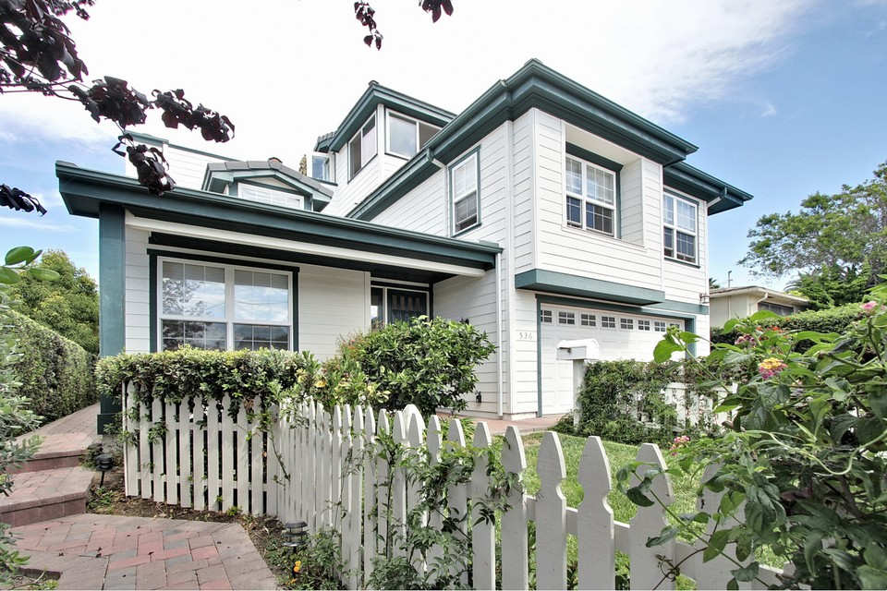

Like-kind Example - #1
Rental Home(s) → Apartment Building
RELINQUISHED
REPLACEMENT
Take advantage of 1031 Tax-Deferral to increase profits.

Slide 10


Like-kind Example - #2
Residential Multi-Unit(s)→Commercial / Medical Building
RELINQUISHED
REPLACEMENT
You can exchange from residential/rentals to commercial properties.

Slide 11


Like-kind Example - #3
Shopping Center → Office Tower
RELINQUISHED
REPLACEMENT
You can leverage your tax deferred equity position to maximize your return.

Slide 12

Dying Malls & Neighborhood Centers
As online sales are expected to generate half of business growth this year. It’s no wonder that 150 major malls have closed in the past 10 years.

Slide 13
Owner Solutions
Owners of malls and small centers that are dated & deteriorating are being forced to drastically reimagine their space.
Remodel & Attract National Brands (NNN Leases)
Exchange Into Residential Rental Properties in Need of TLC - Hold & Rent To Minimize Tax
Exchange To Single Family Rental Homes In ‘Up & Coming’ Areas.
* Remember Warren Buffet ☝️*
Notes:
Attract National Brands

Slide 14

What You Can’t Exchange - #1
Financial and personal assets are not-like-kind.
Stocks, Bonds, & Notes
(with the exception of DST’s) “pass-through entity”
Money & Cash Equivalents
Personal Property

Slide 15



No Longer Eligible
Personal property is no longer eligible for 1031 Like-Kind Exchanges.

Slide 16

What You Can’t Exchange - #2
Securities and business interests are not like-kind.
Certificate of Trust
Interest in Partnership
Other Securities
(with the exception of TIC’s)

Slide 17

What You Can’t Exchange - #3
Residences and foreign properties are not like-kind.
Primary Residences
Second or Vacation Homes
Foreign Properties
Notes:
Total interest write-off for personal home and vacation home = $750k (2018)

Slide 18

Time Frames for Exchange
Key objectives must be met according to schedule.
45-Day Identification
180-Day Exchange
No Exceptions (except Federal disasters)

Slide 19

45-Day Identification Period
You have 45 days to identify replacement properties.

Slide 20

180-Day Exchange Period
You have 180 days from closing of relinquished property to make a purchase of replacement property.

Slide 21

Finding a Replacement Property
There are three rules to identify a new investment.
3 Property Rule
200% Rule
95% Rule

Slide 22
3 Property Rule
Identify up to three replacement properties.
Notes:
explain how one can exchange for up to 3 properties of equal or greater value than relinquished property or simply have 3 properties to choose from

Slide 23

200% Rule
Identify 4+ properties with cumulative value up to 200%.

Slide 24

95% Rule
Must purchase at least 95% of all properties identified.

Slide 25

IRS Requirements
There are four aspects to a successful exchange.
Intent
Form
Substance
Constructive Receipt

Slide 26
Intent
The reason behind conducting the exchange.

Slide 27

Form
Use of a Qualified Intermediary for the exchange.
Notes:
This slide is covering ‘Form’ (from the prior ‘4 IRS Requirements’ slide)

Slide 28
Substance
The holding period is just one of many factors
All facts and circumstances are taken into account
Ideally, the taxpayer has multiple factors to establish the intent to hold for investment
“Intent” is the taxpayers subjective intent
Contrary facts may lead the IRS to conclude that the properties were not held for investment purposes
Notes:
This slide is covering ‘Substance’ (from the prior ‘4 IRS Requirements’ slide)
Warning - parking and/or TIC fractional ownership

Slide 29

Constructive Receipt
All 1031 Funds must be held by a Qualified Intermediary.

Slide 30
Don’t Forget the Boot
Fair market value of non-like-kind (personal) property received in the transaction may be boot.
Boot is money or the fair market value of “other property” received in an exchange (cash, equipment, furnishings…)
If there’s an existing loan on your relinquished property, the loan amount for the replacement property should be equal to or greater than that loan to avoid mortgage boot.
We can collaborate with experts to
determine your unique needs.
Notes:
Insert slide for mortgage boot and partial exchange boot after this one. Personal property along with apartment sale cap gain taxed?

Slide 31

It’s in the Numbers
Consult with your CPA/Tax Attorney to determine:
Capital Improvements
Expenses
Depreciation
Capital Gains Taxes
State Taxes
All Other Factors

Slide 32
Professional Collaboration
Consult With Our Real Estate Brokers That
Specialize in 1031 Exchange
Simplify Complexity
Comparative Market Analysis
Timing Strategy
Network Across Industries
Skilled Negotiation

Slide 33

Exchange Networks
We collaborate with investors all over the US.

Slide 34
Key Concepts
The most important points, one more time.
  Work with us to find new investments.
  Save on taxes with 1031 exchanges.
  Plan your investments strategically.

Slide 35
Take Advantage of the Benefits
Preservation of equity
Leverage
Diversification
Consolidation
Management Relief
Estate Planning
Increased Depreciation
Notes:
Notes regarding depreciation - sell every 5-7 years

Slide 36
Questions?
Ask us anything that is on your mind.
Contact Us
858.255.1031
1237 Prospect St, Suite G
La Jolla, CA
www.CoastalPacificRE.com

